Slide 1
Virtualization: A nowadays must
Manuel García Fernández
Sergio Faya Fernández
Roberto Pérez Sánchez

Slide 2
Defining the concept.
Taking a physical resource, and from it, creating a virtual version, better than the current one.
Example: A hard disk can be divided in “two virtual versions”.
This technique began in the 1960s, with the goal of logically divide the system resources of the primitive computers
Physical Resource
Virtualization
Simulated version

Slide 3
Usefulness of virtualization. CPU virtualization.
Nowadays, computers run many processes at once.
We need a way to share the CPU among them.
But we only have one processor
With no CPU sharing a process can monopolize it
Processes have their own ‘virtual CPU’
CPU is multiplexed in time
Each process has its own execution time
Several processes can run at once
Problems
Advantages
Virtualization

Slide 4
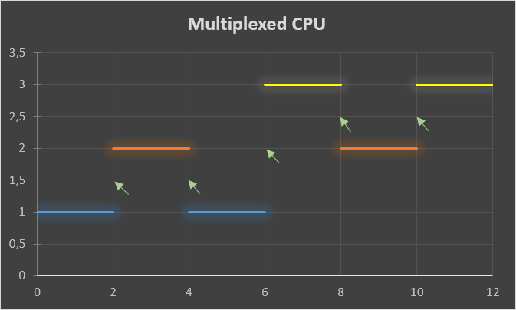
CPU Virtualization.
The coloured lines are processes.
Each process is executed a determined time.
The arrows point to the moment in which CPU change the execution to another process.
The system takes the decision of switching thanks to the policies.

Slide 5

Memory Virtualization
Memory multiplexed in space.
Each process has its own ‘virtual space’.
The data of a process can not intefer with
data of another process.
The user processes can not access to the
OS address space.
Main memory

Slide 6
Memory virtualization. Example.
We have different processes accessing to the same address, 0xABC123.
They access to address 0xABC123 in its own virtual address space.
But that address is not referred the same physical address.
There can be many equal virtual addresses, but there are no
two identical physical address.

Slide 7
Other uses of virtualization.
Resource optimization
Consolidation
Multiple virtual environments
Maximizing uptime
Speedy and flexible recover for some failures
Hardware can be more efectively used.
Virtual machines can be created on existing software
Take advantage of small amount of power that some apps use.
Instant deployment of new virtual machines

Slide 8
Other uses of virtualization.
App protection
Implement redundancy without new hardware.
Migrate Workloads
To improve reliability and availability.
Protect Legacy Systems
Run an old system in a modern virtual machine.
If one virtual system fails, another virtual system takes over.
Move a virtual machine from one physical machine to another.
Nothing changes form application point of view.

Slide 9
Types of virtualization
Goal of virtualization: centralize administrative tasks while improving scalability and overall hardware-resource utilization
Very useful and powerful tool nowadays
6 different types

Slide 10
OS Virtualization
Putting a second or multiple instances of an operating system on a single machine
It reduces hardware and costs
It has an important risk in physical fault

Slide 11
Application-Server Virtualization
Spreads applications among servers and servers across applications
Balance the workload of software: not overload a server or underload an application
Easy management of applications and greater network security
Expensive

Slide 12
Administrative virtualization
Least-known form of virtualization
Used in data centers
Segmented admin roles through group and user policies
For example, certain groups may have access to read specific servers, infrastructure, application files and rules, but not to change them.

Slide 13
Network virtualization
Virtually managing IP addresses
Combine hardware and software networks¡ resources and functionalities into a single virtual network
Faster development, testing and deployment of apps and improved recovery time
It needs training and compatibility

Slide 14
Hardware virtualization
Rarest form of virtualization
Similar to OS virtualization and required for it
Instead of putting multiple instances of an OS on a single machine, partitions of the machine itself are separated to perform specific tasks

Slide 15
Storage virtualization
Enable better functionality in computer data storage systems
Special hardware and software along with disk drives in order to provide very fast and reliable storage for computing and data processing.
Two types: blocky virtualization and file virtualization

Slide 16
Advantages and disavantages
Advantages:
Reducing cost of hardware
Easy backup and disaster recovery system
Better business continuity
Disadvantages:
Expensive to set up
Learning curve
But comparing both, moving to a virtualized working environment is, in most cases, hugely benefitial

Slide 17
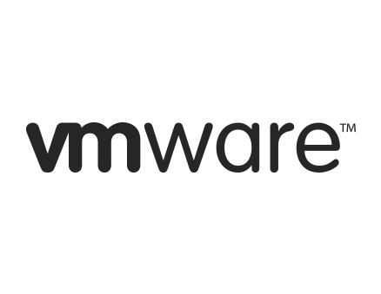
FIRMS AND SOLUTIONS: VMware
One of the first companies to add virtualization
Multiple fields like application and server virtualization are their area of expertise
Since 2005 provided for free development tools for virtualization
Free hypervisors to control their server
Products like Virtual San to datacenters and vCLoud

Slide 18
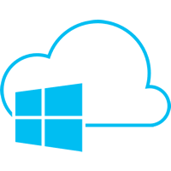
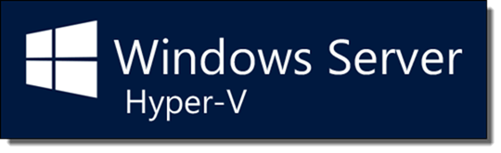
FIRMS AND SOLUTIONS: Microsoft
It is one of the biggest it companies
Focused on windows server and Azure
Their hypervisor is called Hyper-V
Servers are somehow compatible with windows

Slide 19
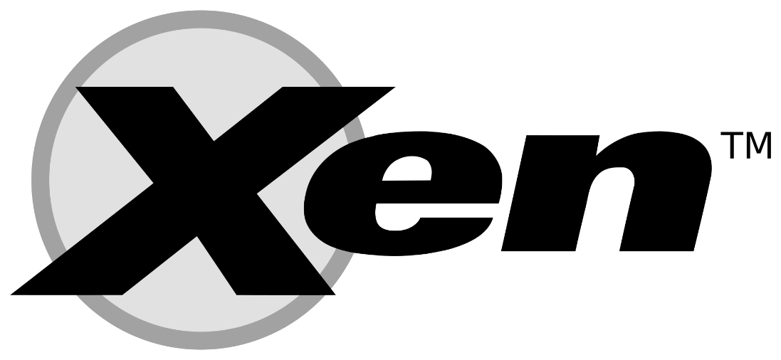
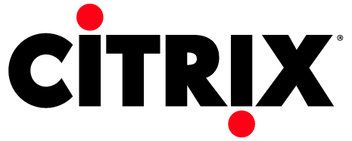
FIRMS AND SOLUTIONS: Citrix
One of the first developers on application virtualization
Provides services for server, networking
Nowadays owns Xen an open source software for virtualization services
Provided some services like XenApp and XenDesktop that add some features to Xen

Slide 20

FIRMS AND SOLUTIONS: Oracle
Owns Java, which works on JVM a remarkable example of good use of a virtual machine
Oracle provides some functionalities in case of Server and Desktop virtualization
Owner of virtual box an important program to create virtual machines
Virtual Box is widely used to access different OSs

Slide 21
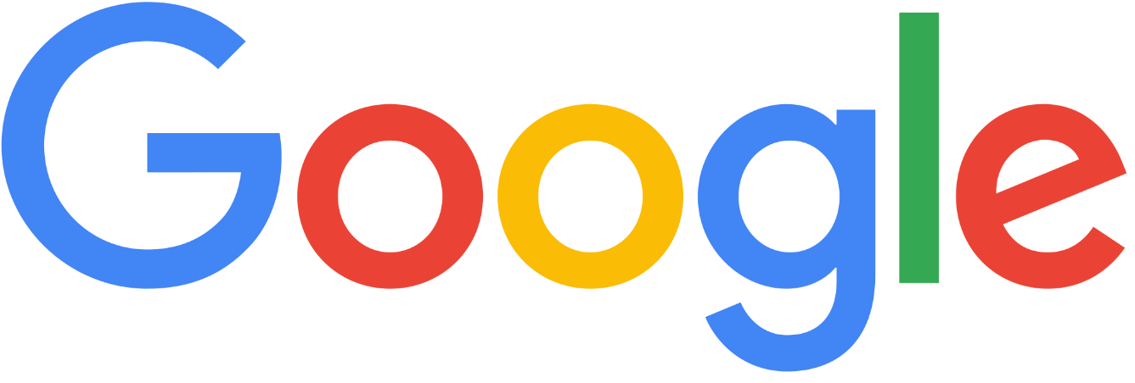

FIRMS AND SOLUTIONS: Google
With all the amount of servers google uses virtualization is a basic utility for such a big company
They use Xen adapting it to their own necessities
They created Ganeti a cluster solution that manages xen hypervisors to make administrator easier to create clusters

Slide 22
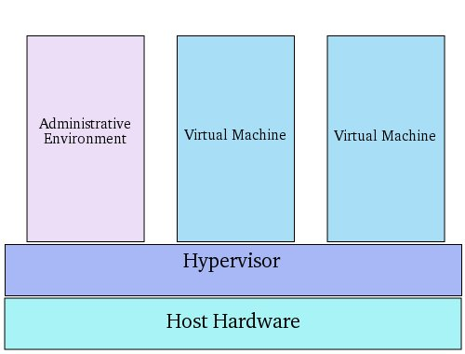
NOWADAYS: Most used techniques
Virtualization is focused to big companies, datacenters and cloud computing
Companies provide mainly SaaS (Software as a Service)
Cluster solutions
Hypervisors

Slide 23
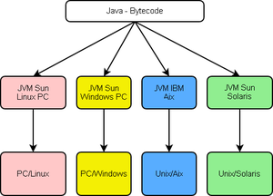
NOWADAYS: A well know VM
JVM is compatible with all systems
Runs over Java bytecode
Bytecode is traduced to every
architecture

Slide 24
Conclusion
Every regular computer has its system virtualized
OS use of virtualization
Provide improvements to physical versions
Datacenters take advantage of all this features.

